Slide 1
Software Quality Assurance
By Ari Butowsky, Daniel Citardi, and Brandon Ng
Notes:
Dan - everyone introduce

Slide 2
Introduction
Article Name - Chapter XVI: Software Quality Assurance
Authors - Dawn M. Owens and Deepak Khazanchi
When the article was written - 2009
Notes:
Ari

Slide 3
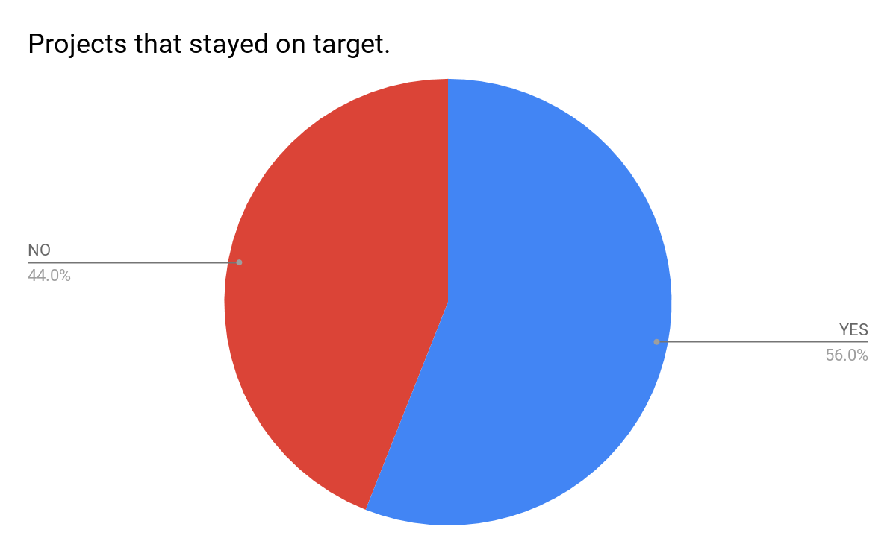
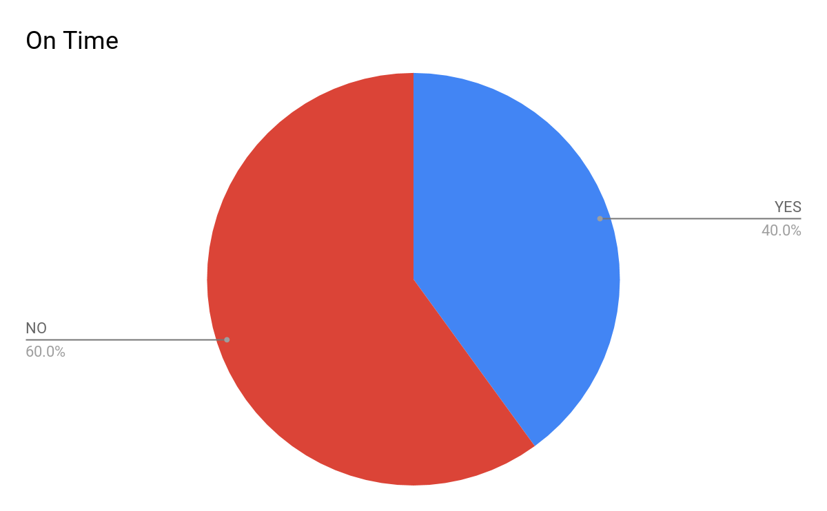
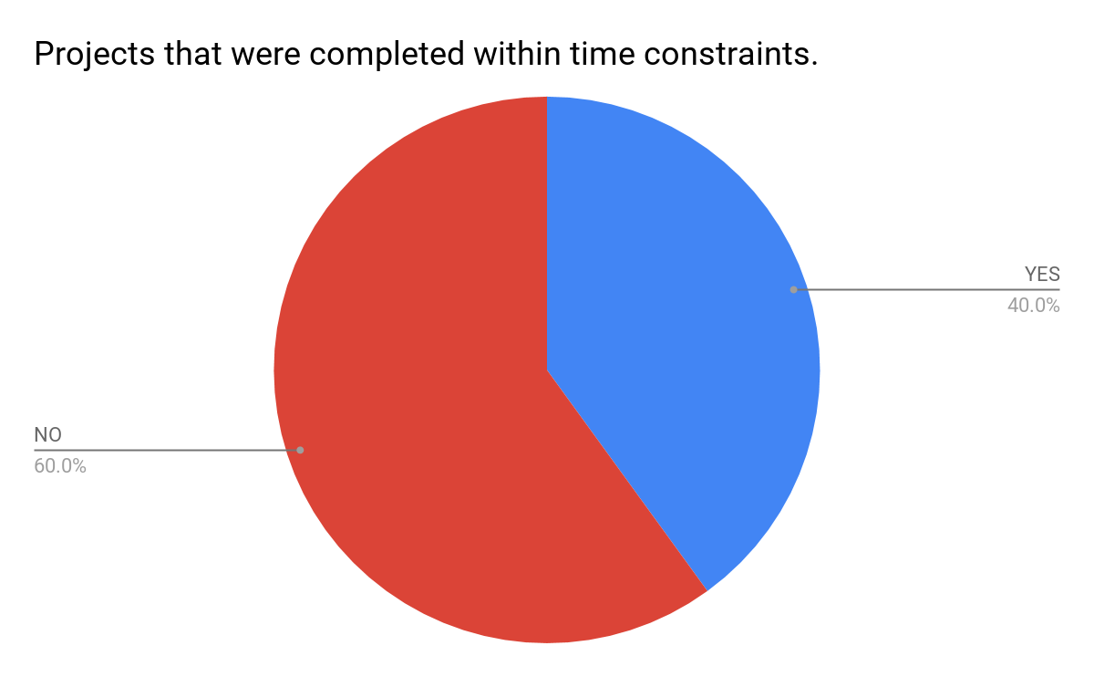
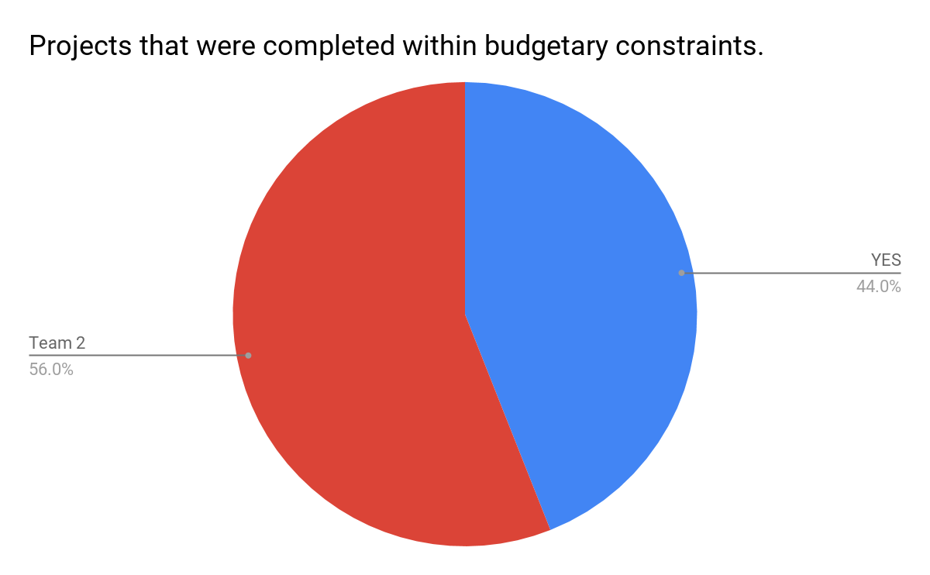
IT Project Statistics
A 2015 report released by the Standish Group studied 50,000 IT projects around the world. One thing covered was how many stayed within budget, were resolved within a reasonable amount of time, and delivered customer and user satisfaction in spite of original scope.
Notes:
Ari

Slide 4
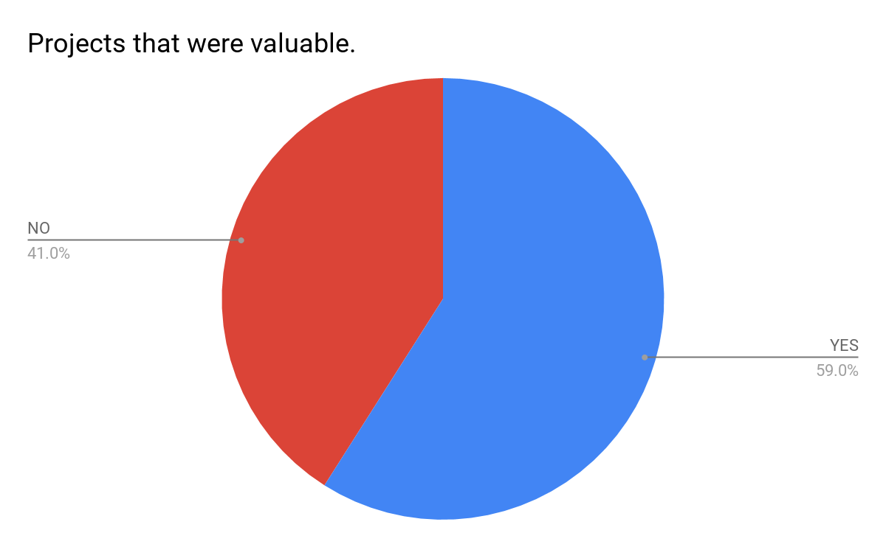
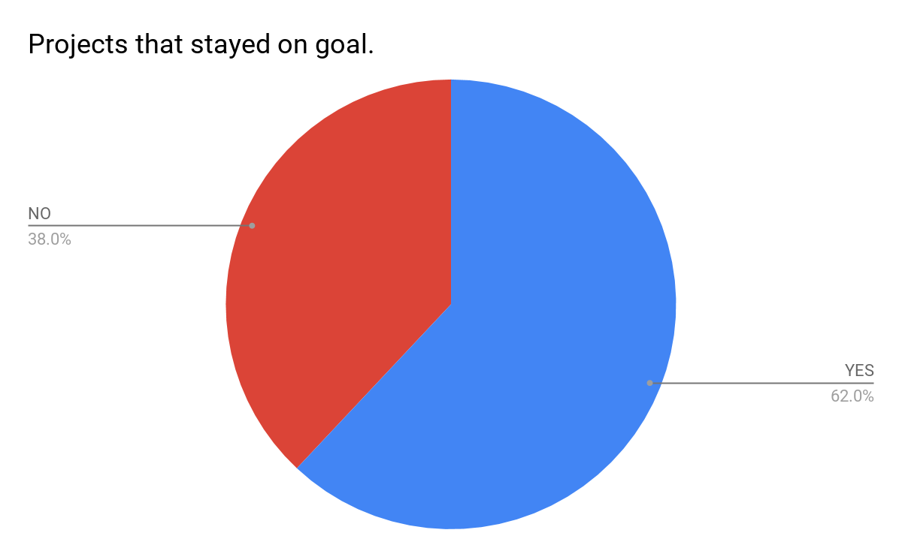

IT Project Statistics (cont’d)
The 2015 report also covered how many IT projects were useful in helping advance an organization’s various objectives, how many did not deviate from the goals for which they were created, and how many satisfied customers through full realization of desired features and functions.
Notes:
Ari

Slide 5
Project Successes and Failures
The 2015 report also went over what percentages of the IT projects were successful, challenged (i.e. Being over budget, late, or having fewer features or functions than originally specified.), and/or failures.
 | 2011 | 2012 | 2013 | 2014 | 2015
Successful | 29% | 27% | 31% | 28% | 29%
Challenged | 49% | 56% | 50% | 55% | 52%
Failed | 22% | 17% | 19% | 17% | 19%
Notes:
Ari

Slide 6


Reasons for Project Management Failures
Cost
Planning
Time
Commitment
Resources
Management
Risk
Communication
Notes:
Dan

Slide 7
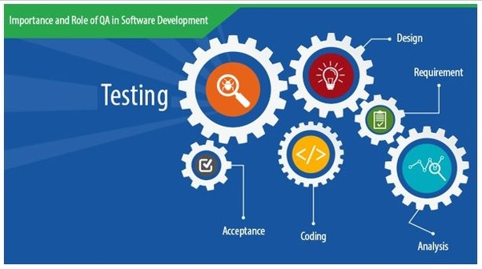
Software Quality Assurance (SQA)
Well-defined, repeatable process that is integrated with software development and project management life cycles.
Objective
Assure conformance to requirements
Reduce risk
Assess internal controls
Improve quality
While conforming to the stated schedule and budget constraints.

Slide 8
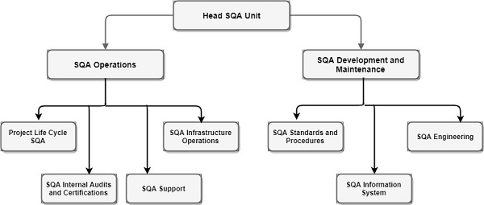
SQA Unit/Function
Independent of project participants.
Consists of SQA professionals, as well as associated actors from among software development and maintenance staff.
The SQA unit reviews documentation for completeness and adherence to standards, partakes in inspections, reviews test results, and audits controls.

Slide 9
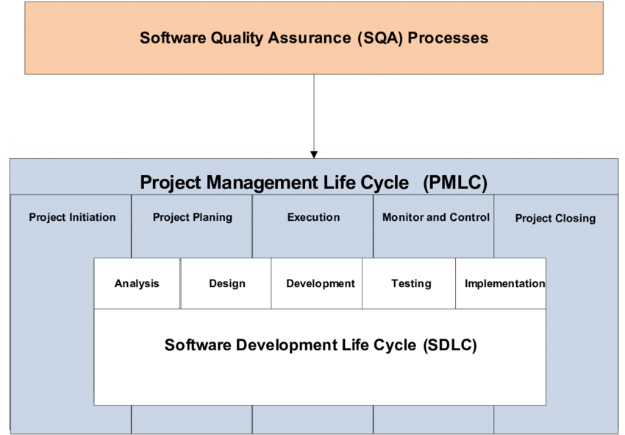
SQA Process
Continuous assessment
Assure project planning has taken place
Assure user requirements
Assure design process
Assure coding practices
Assure software integration and testing
Conduct audits
Series of inputs, outputs, controls

Slide 10
Combined SQA, SDLC, and PMLC Process
The combined PMLC and SDLC life cycle consists of 8 phases, each with a corresponding SQA phase.
Each SQA phase has a loop to a corresponding PMLC or SDLC phase. This loop gives input on issues found during SQA activities and ensures improvement during the combined PMLC and SDLC life cycle.
Combined PMLC and SDLC Life Cycle
Project Initiation
Project Planning
Analysis
Design
Coding
Testing
Implementation
Project Closing
SQA Life Cycle
SQA Initiation
SQA Planning
Requirements Assurance
Design Assurance
Development Assurance
Testing Assurance
Implementation Assurance
SQA Closing

Slide 11

Phase 1: SQA Initiation
Official start or kickoff of a project
Notes:
B

Slide 12

Phase 2: SQA Planning
Deciding in advance what to do, how to do it, when to do it and who will do it
Notes:
B

Slide 13
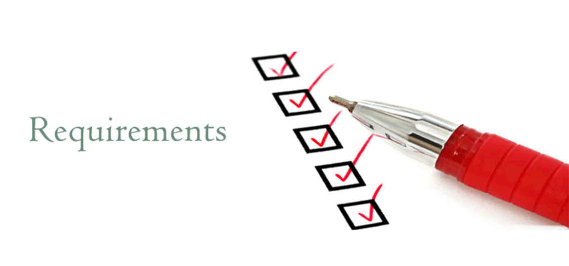
Phase 3: Requirement Assurance
The project team gathers and document formal user requirements.
Notes:
B

Slide 14
Phase 4: Design Assurance
Assure the processes being used to create the design conform to standards and that the design is verified against the established requirements.
Notes:
B

Slide 15

Phase 5: Development Assurance
Assure that the development team is following the stated development process and coding standards
Notes:
B00

Slide 16

Phase 6: Testing Assurance
Providing assurance that adequate testing has been completed and defects have been tracked and recorded
Notes:
B

Slide 17
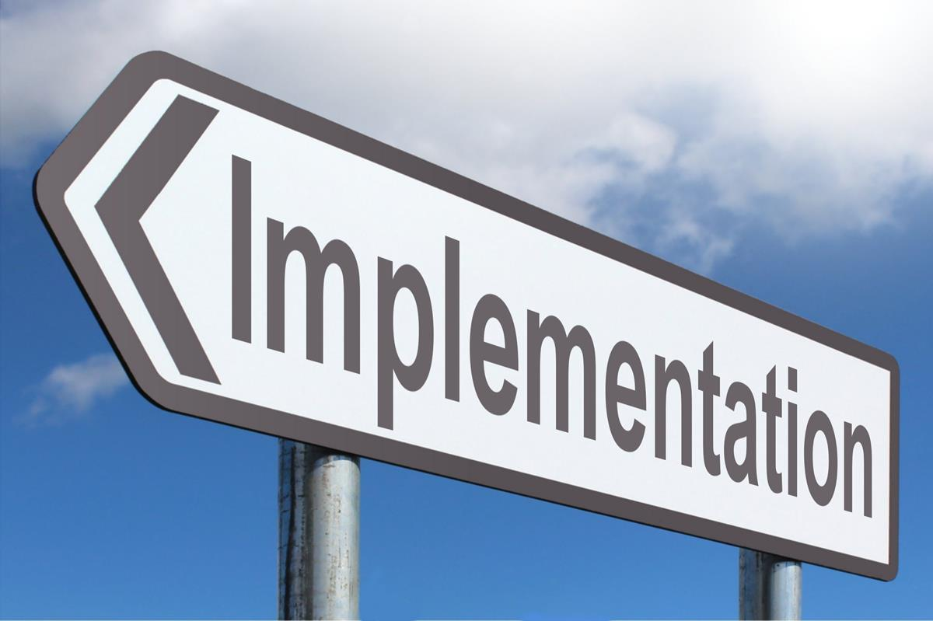
Phase 7: Implementation Assurance
Providing assurance that the necessary steps have been completed before and after installation
Notes:
B

Slide 18

Phase 8: Project Closing
Completing all the assurance process including project closing activities
Notes:
B

Slide 19
Implications For Practice
A method has been developed for creation of an integrated SQA process that must be included at the start of the project.
Metrics and clear deliverables measure the SQA process’ value and support improved development of software products.
Communication needed between stakeholders on general role of SQA process and SQA unit.
Education needed for SQA staff regarding risks, policies, standards, etc.

Slide 20
Implications For Research
The discussed approach to SQA integrates SQA with the SDLC and PMLC.
More research needs to be done in order to:
Better comprehend the risks present in and controls needed in each phase of software development.
Understand how necessary controls are used and if other factors should be considered as well.
Notes:
D

Slide 21
Conclusion
Project failures can happen for many different reasons
The SQA process is vital and skipping or slacking on different steps will hurt the whole project
A consolidated definition of SQA has been proposed and an SQA process has been developed that encompasses the SDLC and PMLC.
Notes:
D

Slide 22

Questions?

